Slide 1



EE 464 Term Project DC-DC Converter Design
Doge Power Inc.
Onur Öztaş 2330389
Mustafa Yıldız 2233013

Slide 2
Project Specifications
DC/DC
Converter
12V DC output voltage
Isolated signal
100W output power
Less than 4% voltage ripple
Less than 3% line regulation
Less than 3% load regulation
220V-400V DC Voltage

Slide 3
Topology Selection
Push Pull
Advantages:
Better transformer utilization
Core size is small compared to others
Transformer ratings are smaller
Small output filter requirement
Disadvantages:
Center Tap Transformer configuration

Slide 4
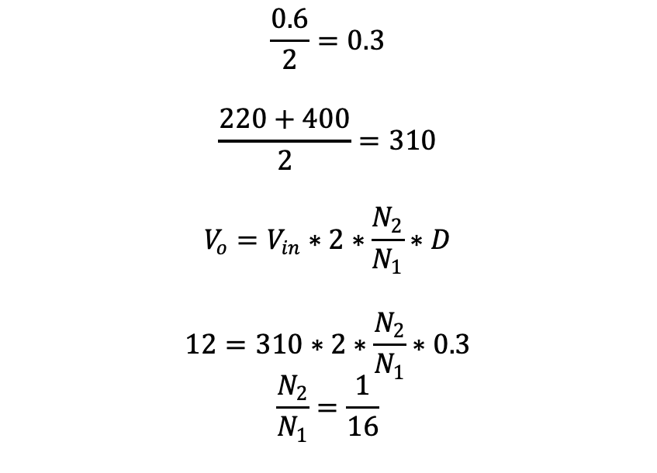
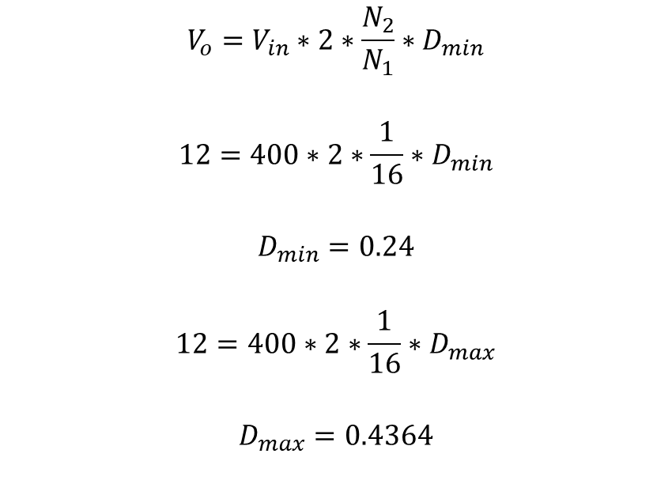
Analytical Calculations
Calculation of Turns Ratio
Limit Values of Duty Cycle
$$\frac{0.6}{2}=0.3$$
$$\frac{220+400}{2}=310$$
$$V_{o}=V_{in}∗2∗\frac{N_{2}}{N_{1}}∗D$$
$$12=310∗2∗\frac{N_{2}}{N_{1}}∗0.3$$
$$\frac{N_{2}}{N_{1}}=\frac{1}{16}$$
$$V_{o}=V_{in}∗2∗\frac{N_{2}}{N_{1}}∗D_{min}$$
$$12=400∗2∗\frac{1}{16}∗D_{min}$$
$$D_{min}=0.24$$
$$12=400∗2∗\frac{1}{16}∗D_{max}$$
$$D_{max}=0.4364$$

Slide 5


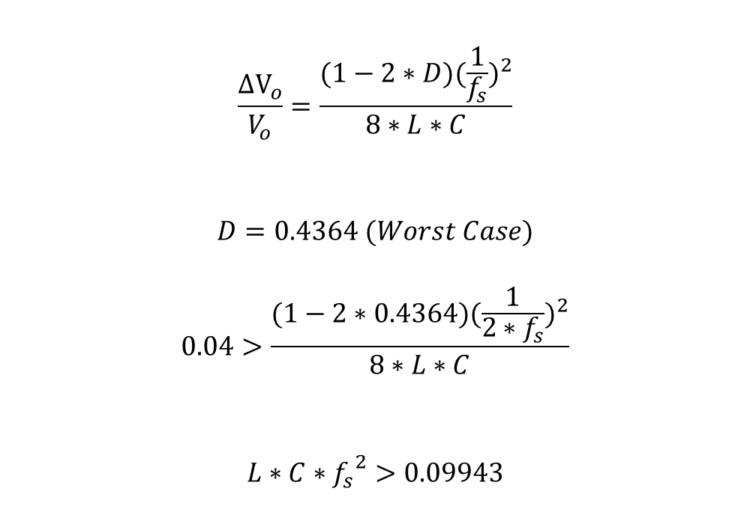
Analytical Calculations
Calculation of main parameters
f=100kHz
$$\frac{{ΔV}_{o}}{V_{o}}=\frac{(1−2∗D){(\frac{1}{f_{s}})}^{2}}{8∗L∗C}$$
$$D=0.4364 (Worst Case)$$
$$0.04>\frac{(1−2∗0.4364){(\frac{1}{{2∗f}_{s}})}^{2}}{8∗L∗C}$$
$$L∗C∗{f_{s}}^{2}>0.09943$$
$$L∗C>\frac{0.09943}{{(10∗{10}^{3})}^{2}}$$
$$L∗C>9.943∗{10}^{−12}$$
L=160μH
$$C>\frac{9.943∗{10}^{−12}}{160∗{10}^{−6}}$$
$$C>62.15 nF$$

Slide 6
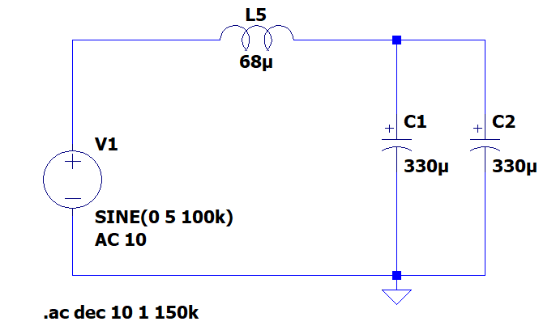
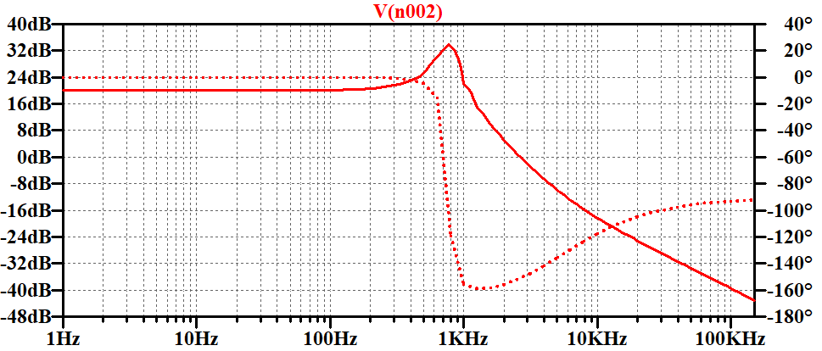
Output Filter Design

Slide 7
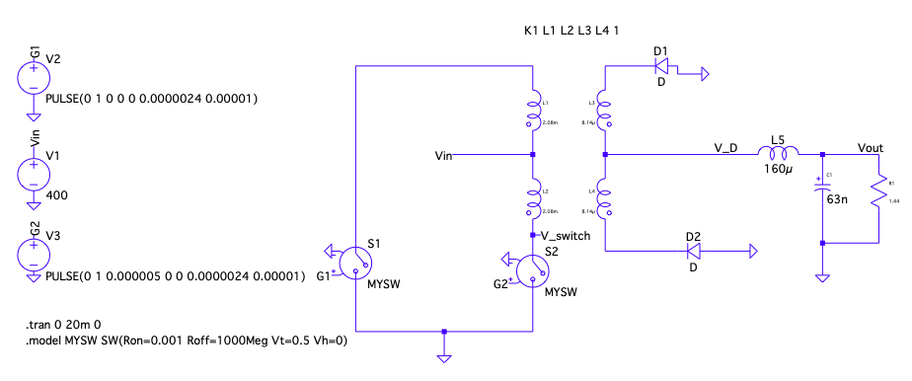
Analytical Calculations

Slide 8
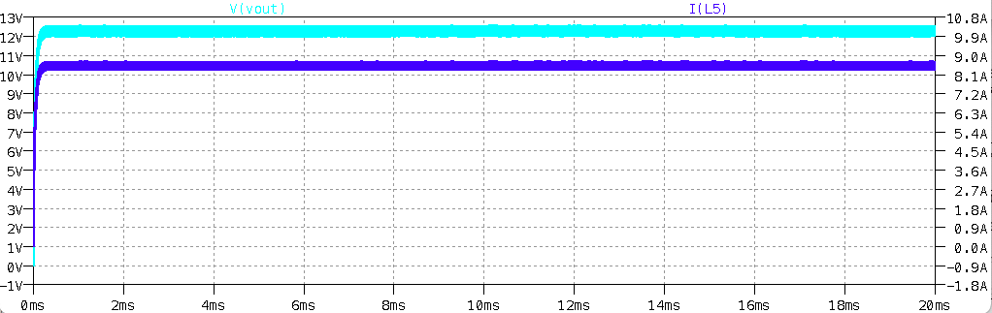
Analytical Calculations

Slide 9
Analytical Calculations
Current Rating of Output Inductor
8.333 A
Voltage Rating of Output Capacitor
12 V
Voltage Rating of Diodes
50 V (blocking)
Current Rating of Diodes
9 A (forward)
Voltage Rating of Switches
800 V (blocking)
Current Rating of Switches
800 mA

Slide 10
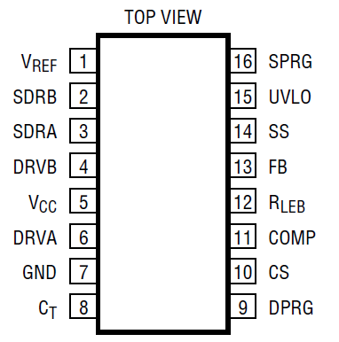
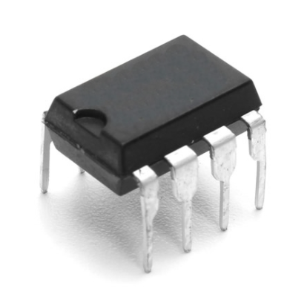
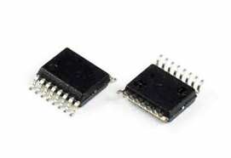
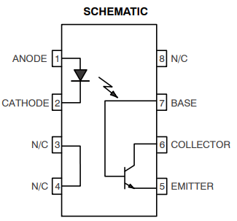
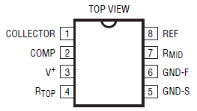
Controller Design
LTC3723 Current Mode Controller
LT1431 Programmable Reference
(Opto – Driver )
Opto-Coupler
MOC207

Slide 11
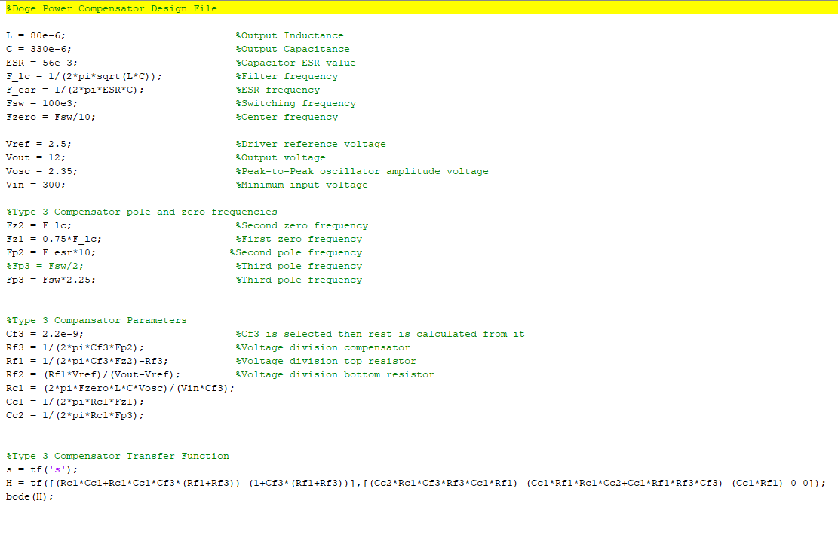
Controller Compensator Design

Slide 12
Controller Compensator Design

Slide 13
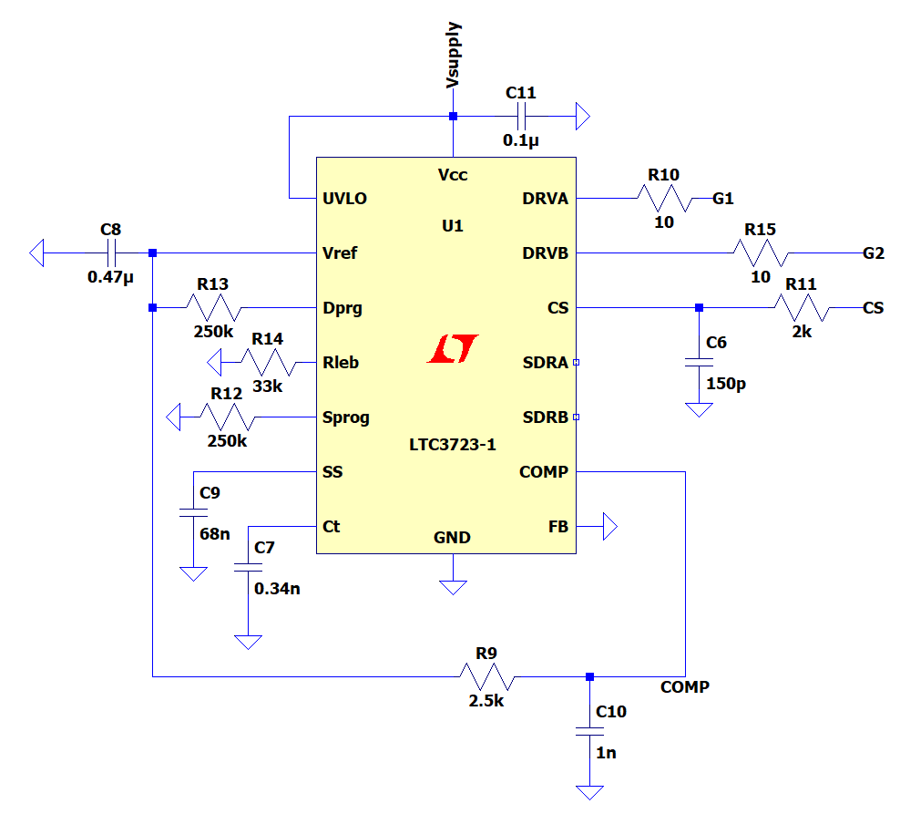
Controller Compensator Design

Slide 14
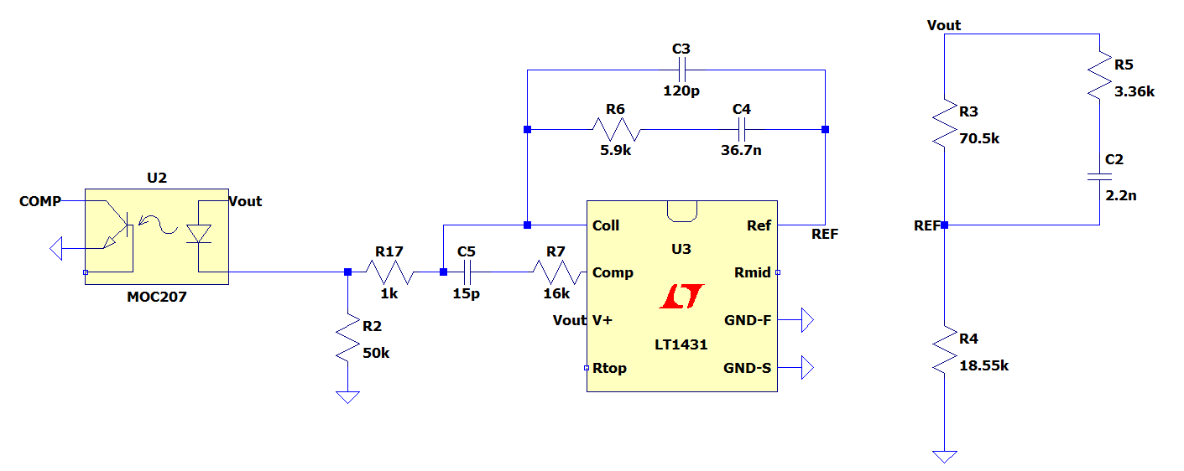
Controller Compensator Design

Slide 15
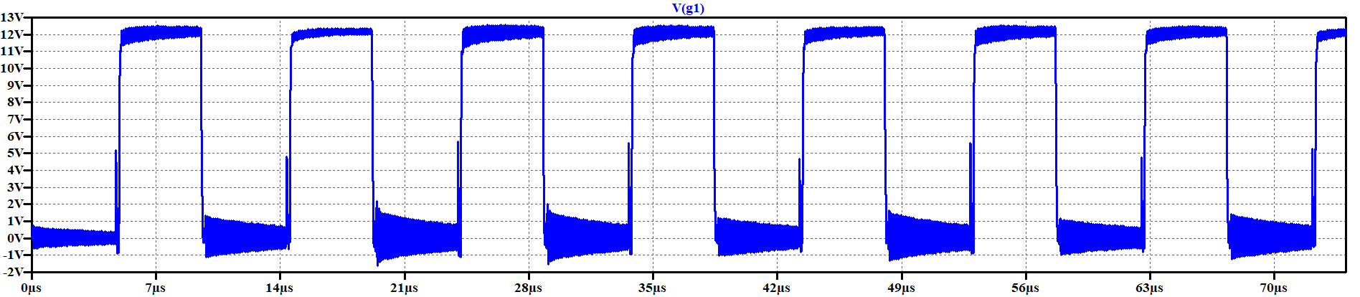
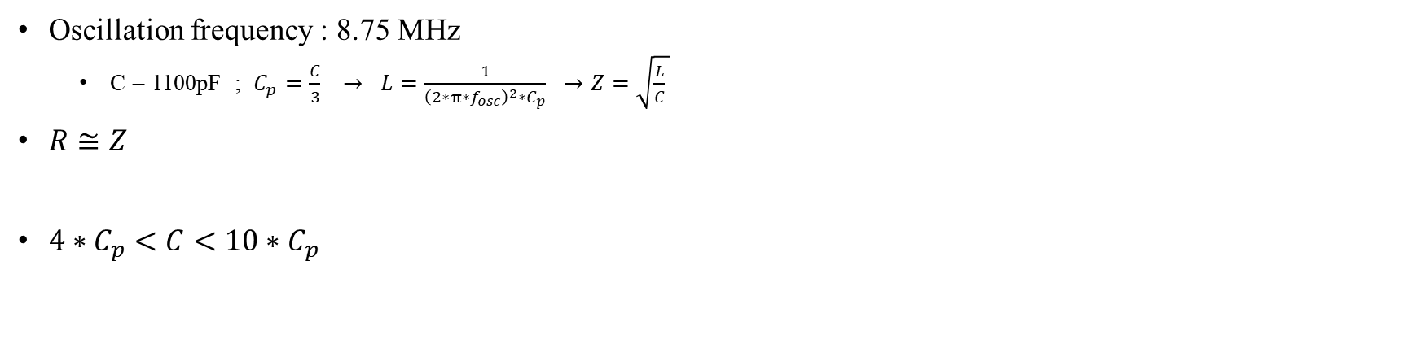
Snubber Design
Oscillation frequency : 8.75 MHz
C = 1100pF ; $C_{p}=\frac{C}{3} → L=\frac{1}{{\left(2∗π∗f_{osc}\right)}^{2}∗C_{p}} →Z=\sqrt{\frac{L}{C} }$
$R≅Z$
$4∗C_{p}<C<10∗C_{p}$

Slide 16
Snubber Design

Slide 17
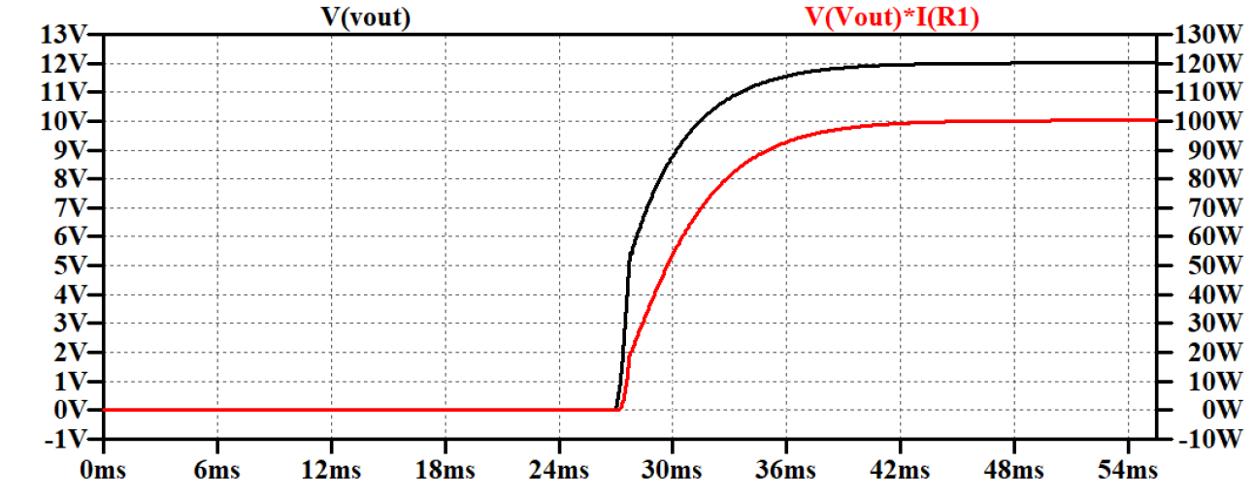
Simulation Results
220V input voltage

Slide 18
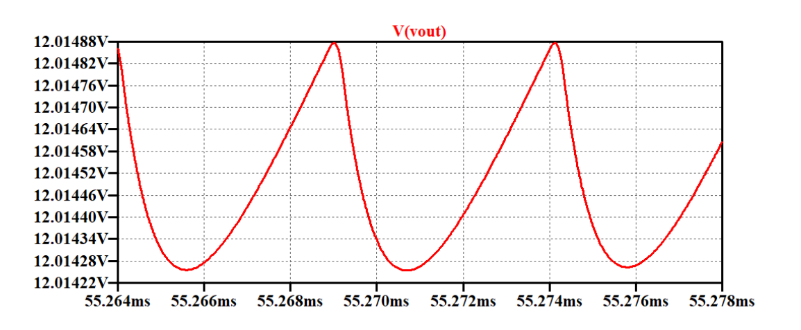
Simulation Results
220V input voltage – output voltage ripple

Slide 19
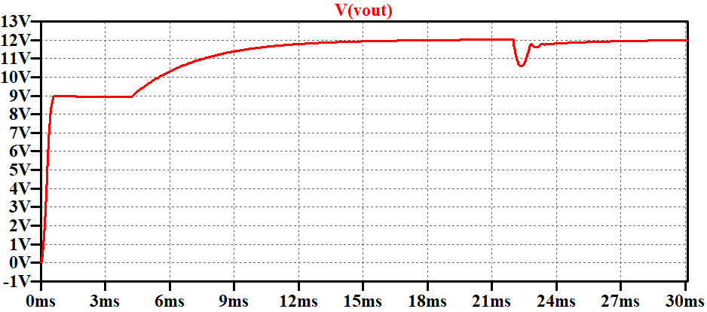
Simulation Results
220V input, No load to Full Load

Slide 20
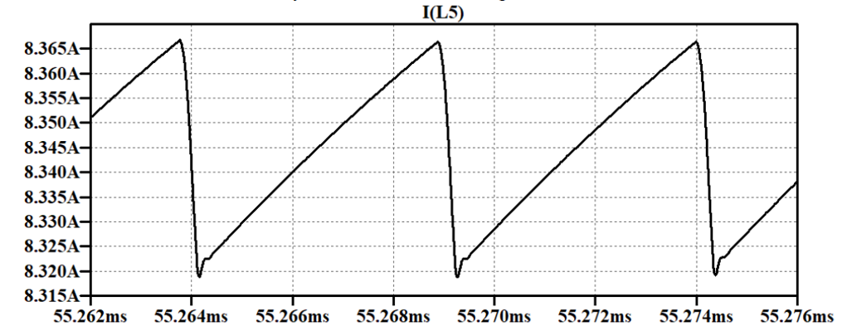
Simulation Results
220V input, inductor current waveform

Slide 21
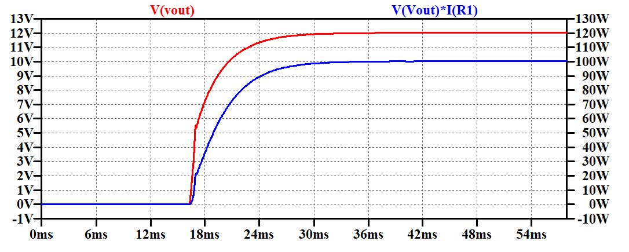
Simulation Results
400V input voltage

Slide 22
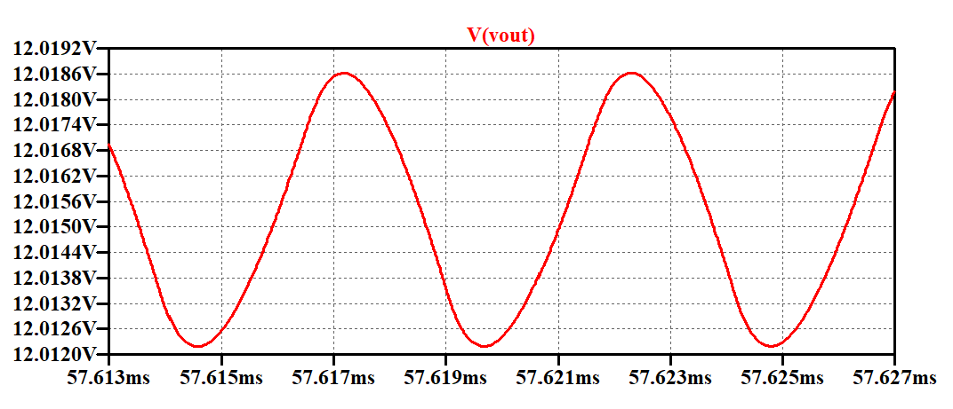
Simulation Results
400V input voltage – output voltage ripple

Slide 23
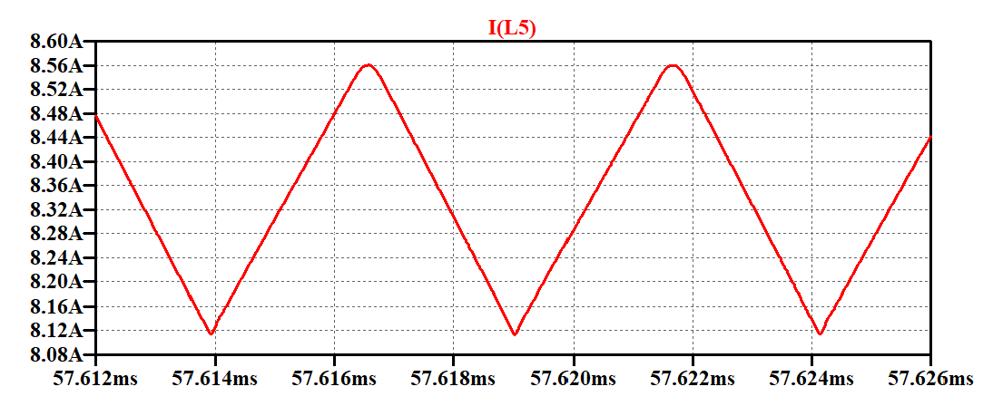
Simulation Results
400V input, inductor current waveform

Slide 24
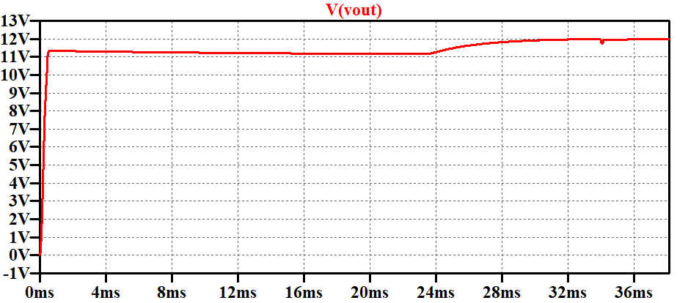
Simulation Results
400V input, No load to Full Load

Slide 25
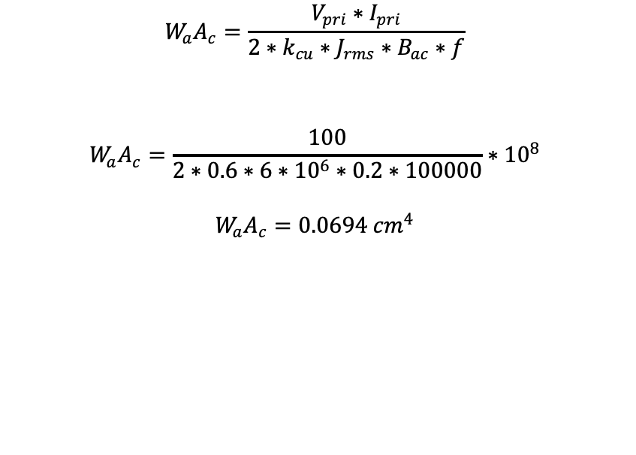
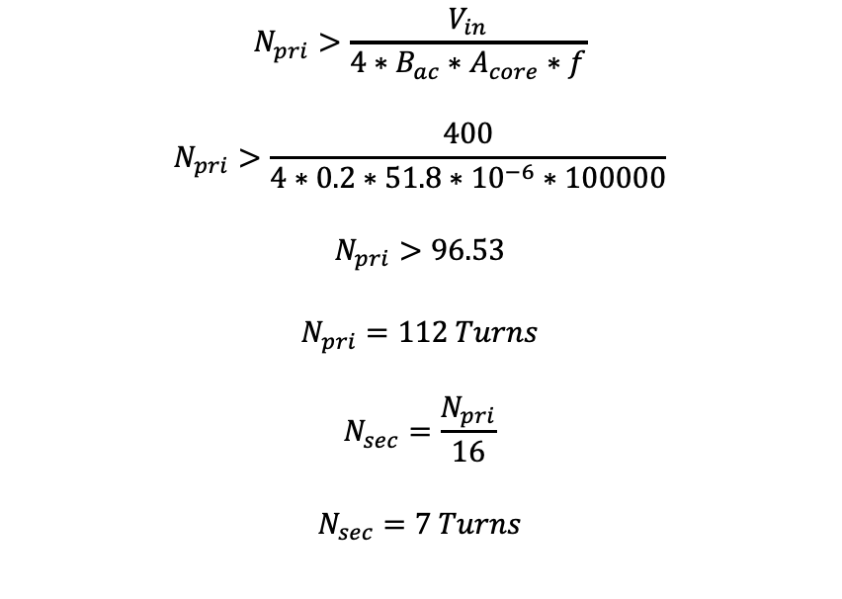
Magnetic Design of Transformer
Area Product
Minimum turns for not saturating the core
$$W_{a}A_{c}=\frac{V_{pri}∗I_{pri}}{{2∗k}_{cu}∗J_{rms}∗B_{ac}∗f}$$
$$W_{a}A_{c}=\frac{100}{2∗0.6∗6∗{10}^{6}∗0.2∗100000}∗{10}^{8}$$
$$W_{a}A_{c}=0.0694 {cm}^{4}$$
$$N_{pri}>\frac{V_{in}}{4∗B_{ac}∗A_{core}∗f}$$
$$N_{pri}>\frac{400}{4∗0.2∗51.8∗{10}^{−6}∗100000}$$
$$N_{pri}>96.53$$
$$N_{pri}=112 Turns$$
$$N_{sec}=\frac{N_{pri}}{16}$$
$$N_{sec}=7 Turns$$

Slide 26
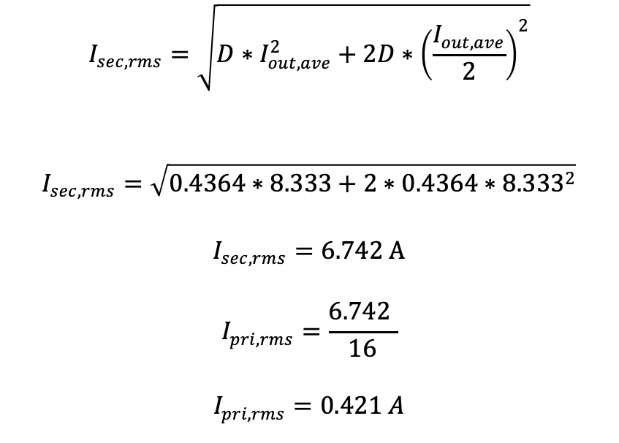
Magnetic Design of Transformer
Primary and Secondary Currents
Specifications
$$I_{sec,rms}=\sqrt{D∗I_{out,ave}^{2}+2D∗{\left(\frac{I_{out,ave}}{2}\right)}^{2}}$$
$$I_{sec,rms}=\sqrt{0.4364∗8.333+2∗0.4364∗{8.333}^{2}}$$
$$I_{sec,rms}=6.742 A$$
$$I_{pri,rms}=\frac{6.742 }{16}$$
$$I_{pri,rms}=0.421 A$$
Input Current
0.421A at 100kHz
AWG 26 (due to frequency)
Output Current
6.742A DC with 100kHz ripples
AWG 26 (due to frequency) x 10 paralleled
2 EER cores
0R42513EC

Slide 27
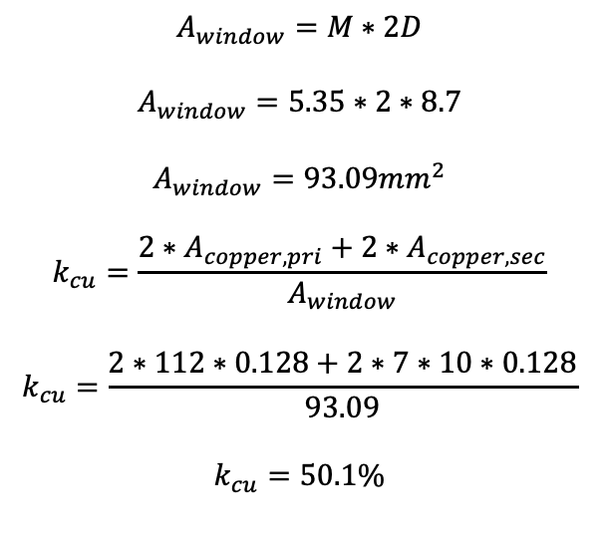
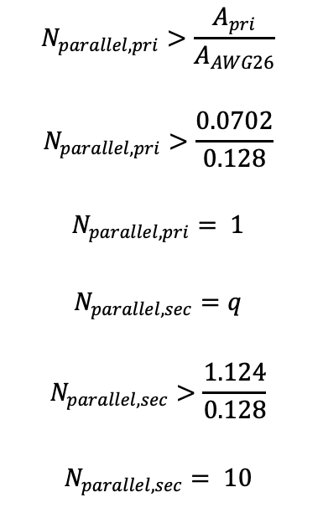
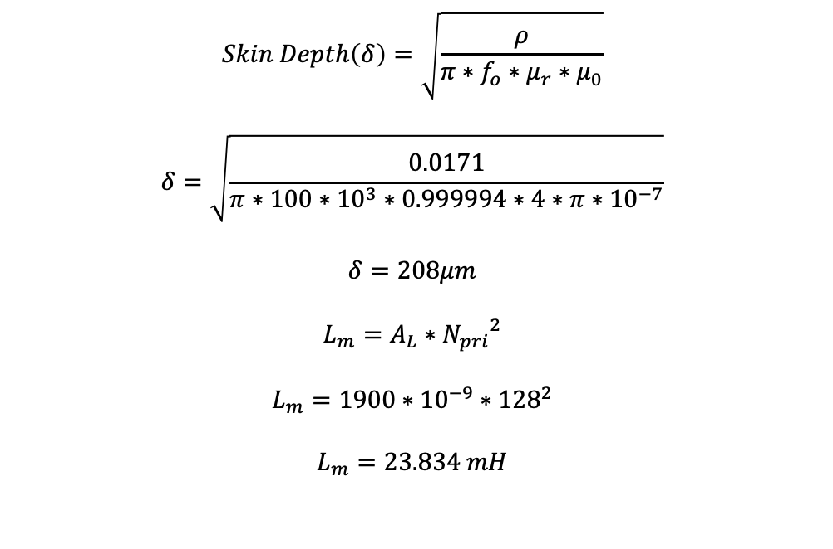
Magnetic Design of Transformer
Conductor Area and Fill Factor
Skin Depth and Magnetizing Inductance
$$Skin Depth\left(δ\right)=\sqrt{\frac{ρ}{π∗f_{o}∗μ_{r}∗μ_{0}}}$$
$$δ=\sqrt{\frac{0.0171}{π∗100∗10^{3}∗0.999994∗4∗π∗10^{−7}}}$$
$$δ=208μm$$
$$L_{m}=A_{L}∗{N_{pri}}^{2}$$
$$L_{m}={1900∗10}^{−9}∗{128}^{2}$$
$$L_{m}=23.834 mH$$
$$N_{parallel,pri}>\frac{A_{pri}}{A_{AWG26}}$$
$$N_{parallel,pri}>\frac{0.0702}{0.128}$$
$$N_{parallel,pri}= 1$$
$$N_{parallel,sec}=q$$
$$N_{parallel,sec}>\frac{1.124}{0.128}$$
$$N_{parallel,sec}= 10$$
$$A_{window}=M∗2D$$
$$A_{window}=5.35∗2∗8.7$$
$$A_{window}=93.09{mm}^{2}$$
$$k_{cu}=\frac{{2∗A}_{copper,pri}+2∗A_{copper,sec}}{A_{window}}$$
$$k_{cu}=\frac{2∗112∗0.128+2∗7∗10∗0.128}{93.09}$$
$$k_{cu}=50.1\%$$

Slide 28
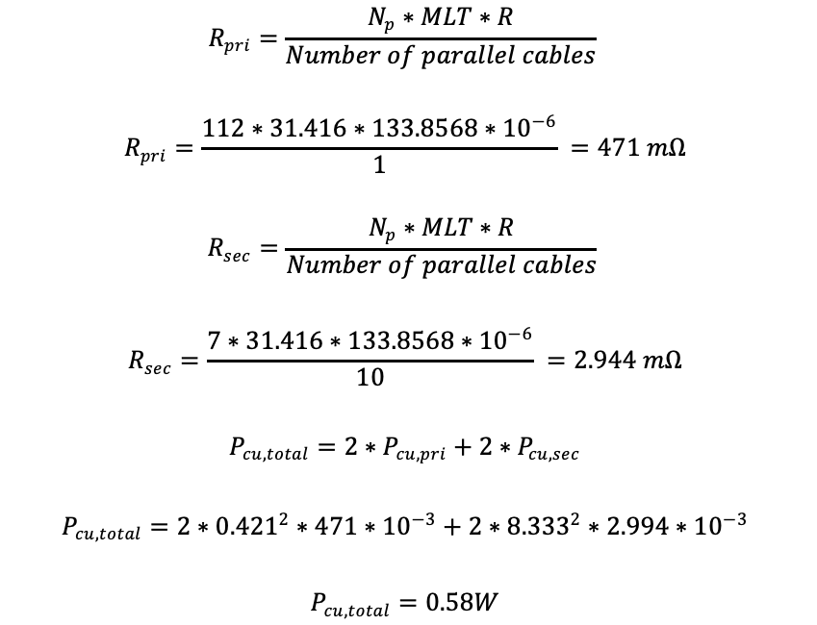
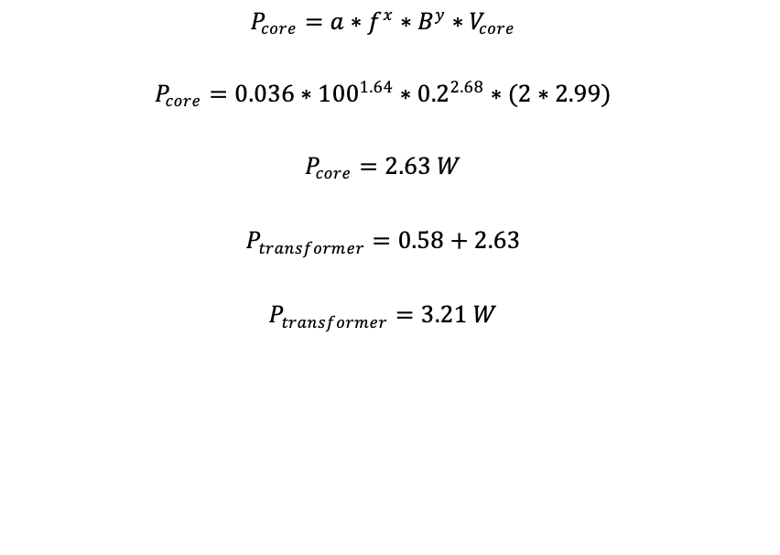
Magnetic Design of Transformer
Copper Losses
Core Losses
$$R_{pri}=\frac{N_{p}∗MLT∗R}{Number of parallel cables}$$
$$R_{pri}=\frac{112∗31.416∗133.8568{∗10}^{−6}}{1} =471 mΩ$$
$$R_{sec}=\frac{N_{p}∗MLT∗R}{Number of parallel cables}$$
$$R_{sec}=\frac{7∗31.416∗133.8568{∗10}^{−6}}{10} =2.944 mΩ$$
$$P_{cu,total}=2∗P_{cu,pri}+2∗P_{cu,sec}$$
$$P_{cu,total}=2∗{0.421}^{2}∗471∗{10}^{−3}+2∗{8.333}^{2}∗2.994∗{10}^{−3}$$
$$P_{cu,total}=0.58W$$
$$P_{core}=a∗f^{x}∗B^{y}∗V_{core}$$
$$P_{core}=0.036∗{100}^{1.64}∗{0.2}^{2.68}∗(2∗2.99)$$
$$P_{core}=2.63 W$$
$$P_{transformer}=0.58+2.63$$
$$P_{transformer}=3.21 W$$

Slide 29
Component Selection
Key parts are:
Controllers
MOSFETs
Diodes
Thermal Analysis and Heatsink

Slide 30
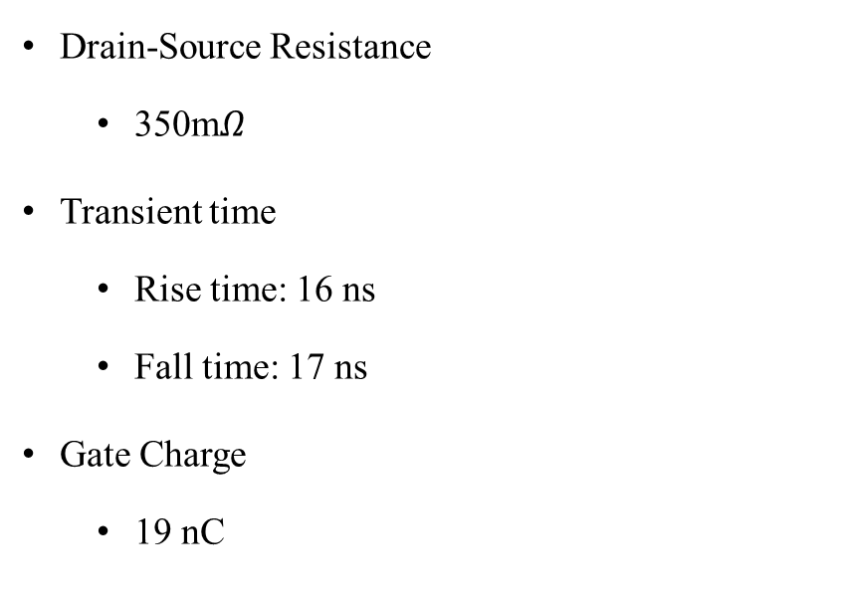
Component Selection
MOSFET
Diodes
Drain-Source Resistance
350m$Ω$
Transient time
Rise time: 16 ns
Fall time: 17 ns
Gate Charge
19 nC
Forward voltage
0.56 V

Slide 31
Component Selection - Controllers
LTC3723-1
LT1431
MOC207M
Controller + Gate Driver
Non-isolated – Required external isolation
Dead-Time control
Frequency control
Soft start property
2 gate synchronous drive capability
Opto-coupler driver
Internal compensator design property
Opto-Isolator

Slide 32
Project Bill of Material
Project Cost
$43,264 for 1000 pieces
Total $43.264

Slide 33
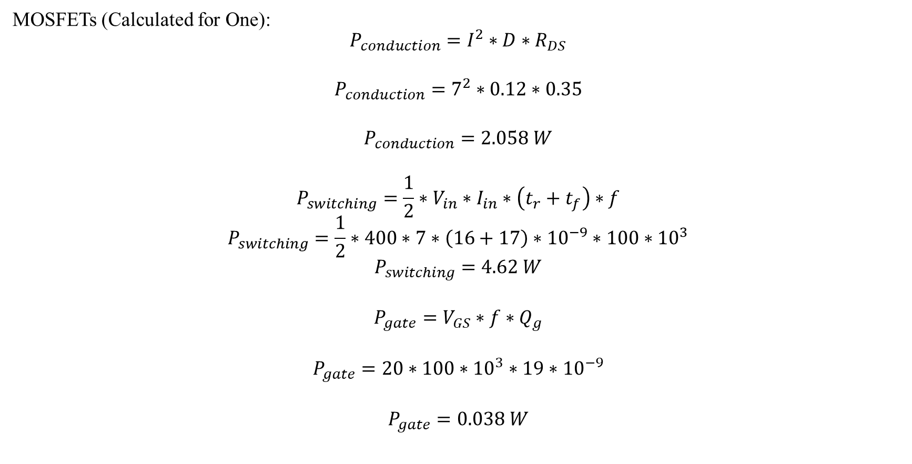
Loss Calculations
MOSFETs (Calculated for One):
$$P_{conduction}=I^{2}∗D∗R_{DS}$$
$$P_{conduction}=7^{2}∗0.12∗0.35$$
$$P_{conduction}=2.058 W$$
$$P_{switching}=\frac{1}{2}∗V_{in}∗I_{in}∗\left(t_{r}+t_{f}\right)∗f$$
$$P_{switching}=\frac{1}{2}∗400∗7∗\left(16+17\right)∗{10}^{−9}∗100∗{10}^{3}$$
$$P_{switching}=4.62 W$$
$$P_{gate}=V_{GS}∗f∗Q_{g}$$
$$P_{gate}={20∗100∗10}^{3}∗19∗{10}^{−9}$$
$$P_{gate}=0.038 W$$

Slide 34
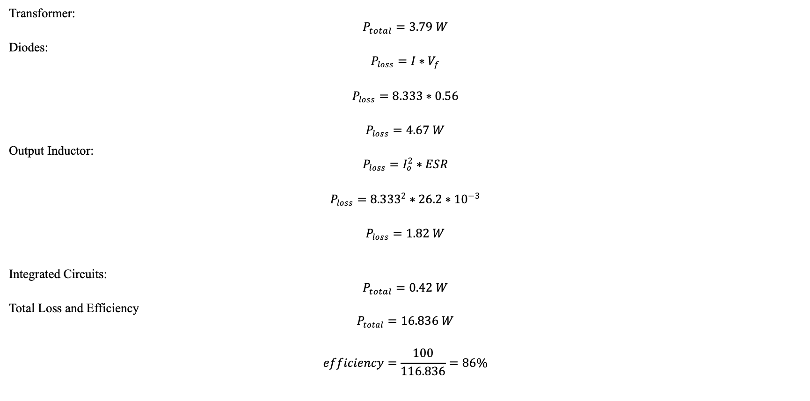
Loss Calculations
Transformer:
$$P_{total}=3.79 W$$
Diodes:
$$P_{loss}=I∗V_{f}$$
$$P_{loss}=8.333∗0.56$$
$$P_{loss}=4.67 W$$
Output Inductor:
$$P_{loss}=I_{o}^{2}∗ESR$$
$$P_{loss}={8.333}^{2}∗26.2∗{10}^{−3}$$
$$P_{loss}=1.82 W$$
Integrated Circuits:
$$P_{total}=0.42 W$$
Total Loss and Efficiency
$$P_{total}=16.836 W$$
$$efficiency=\frac{100}{116.836}=86\%$$

Slide 35
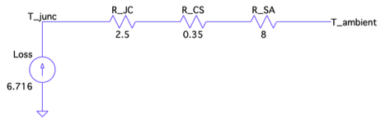
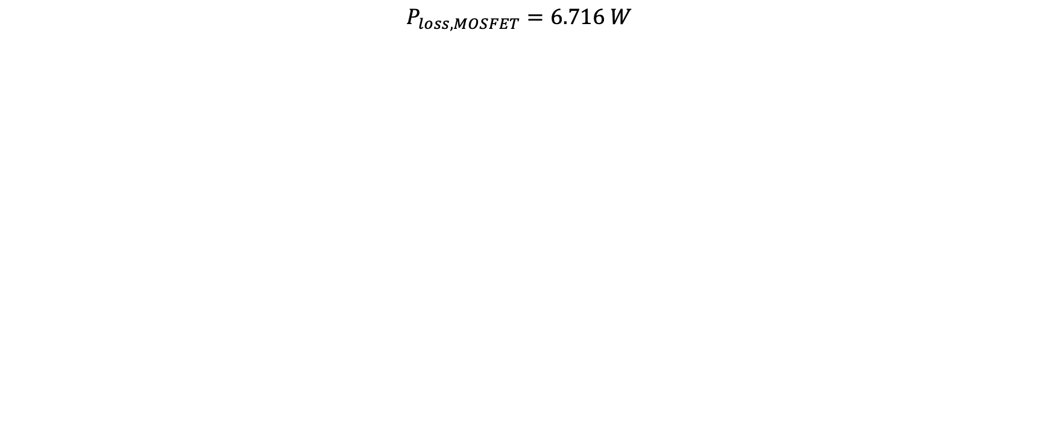

Thermal Analysis - MOSFET
$$P_{loss,MOSFET}=6.716 W$$
$$T_{junction}=\left(8+0.35+2.5\right)∗6.716+25$$
$$T_{junction}={97.87}^{o}C$$

Slide 36
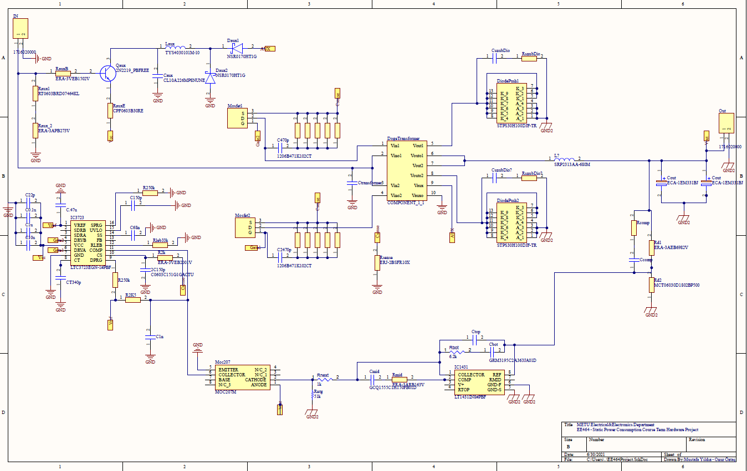
PCB Schematic

Slide 37
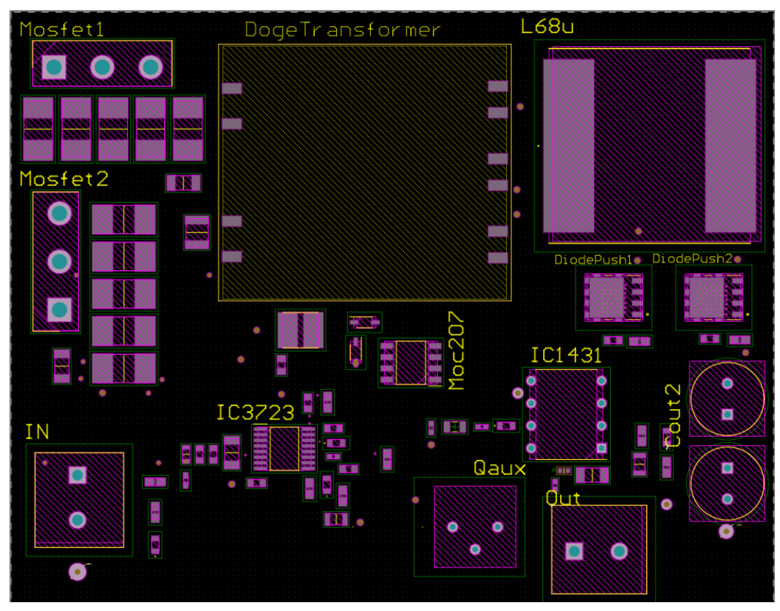
PCB Layout

Slide 38
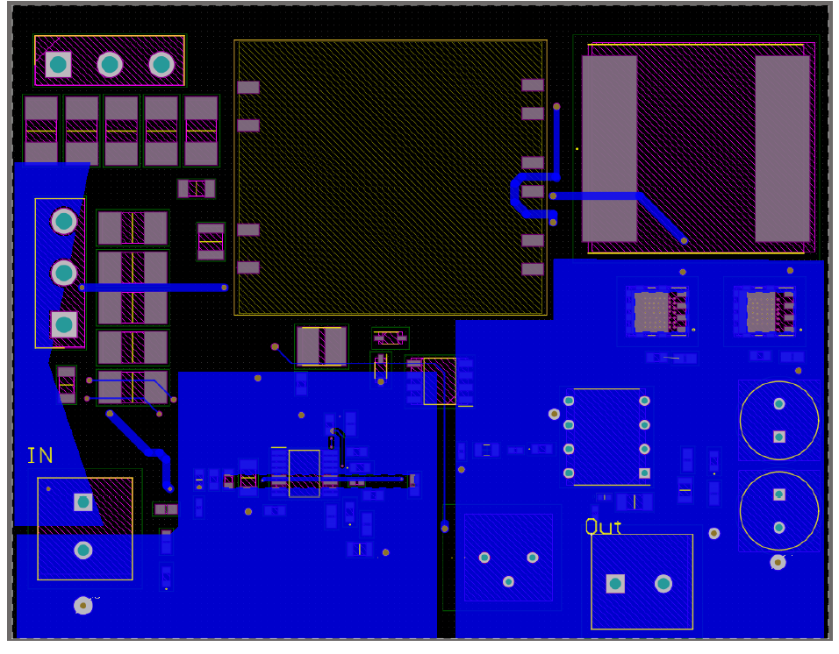
PCB Layout – Bottom Layer

Slide 39
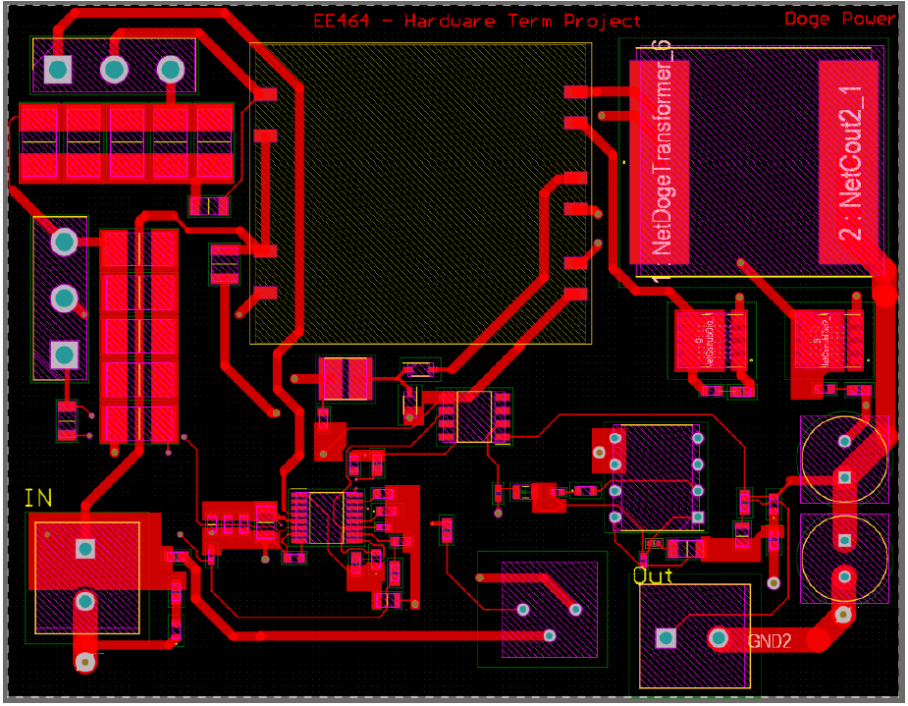
PCB Layout – Top Layer

Slide 40
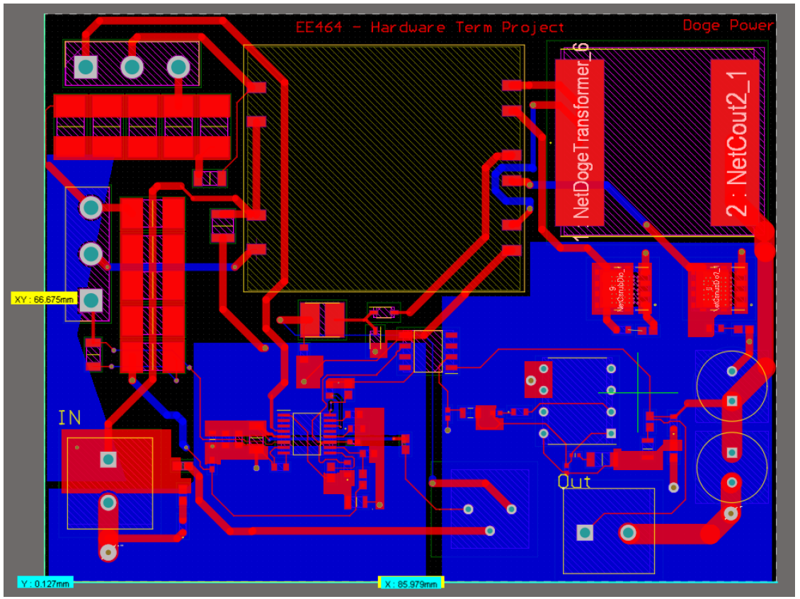
PCB Layout – Board Size

Slide 41
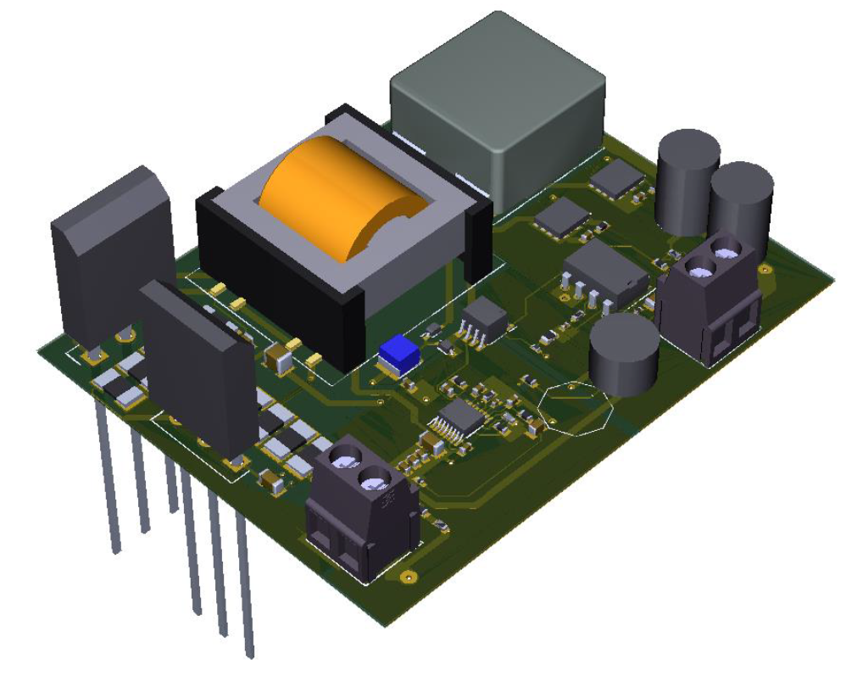
PCB Board 3D Representation

Slide 42
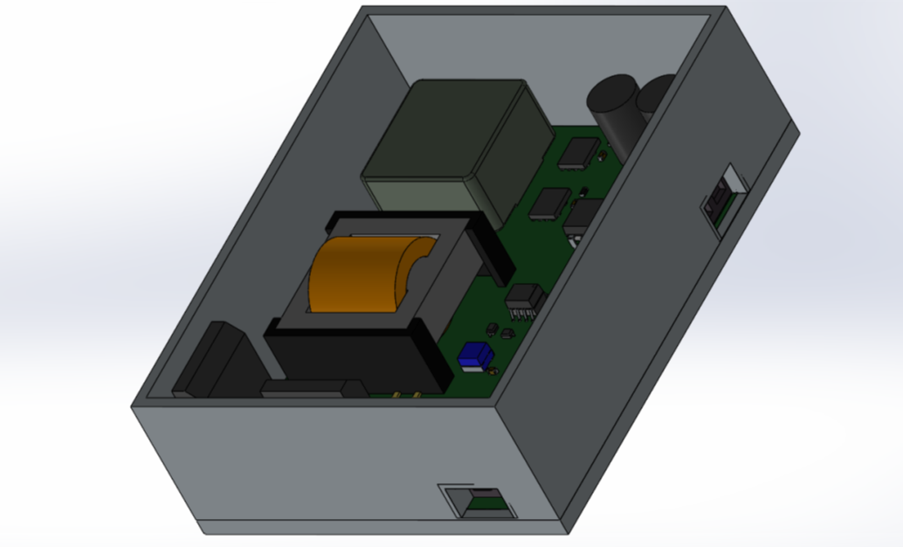
PCB Box Design

